Slide 1

Same Species or Different Animal? : a working comparison between Systematic Reviews and Qualitative Evidence Syntheses
Dr Andrew Booth, Reader in Evidence Based Information Practice,
School of Health and Related Research (ScHARR), University of Sheffield
Presentation for Bangor Evidence Synthesis Hub, Bangor University, 17/02/17
Notes:
Same Species or Different Animal?: a working comparison between Systematic Reviews and Qualitative Evidence Syntheses
Existing methodology for systematic reviews of qualitative research (also known as qualitative evidence syntheses) either assumes that they can be patterned on systematic reviews of effectiveness or that they represent a demonstrably different type of process and output. To what extent can these views be reconciled, if at all? What are the implications of these contrasting views for the development of systematic review methods more generally?

Slide 2
Overview
Qualitative Evidence Synthesis (QES) is an exciting and growing field of systematic review
QES inhabits an uncertain meeting point between systematic review methods and primary qualitative research
When QES “mimics” quantitative systematic review it becomes Frankenstein’s Monster!
When performed appropriately and in a way sensitive to the primary qualitative tradition QES can make a valuable contribution to knowledge
We should not allow “unsound” QES applications to justify not performing QES at all!
Judicious use of QES methods can expand the systematic review toolbox more generally

Slide 3
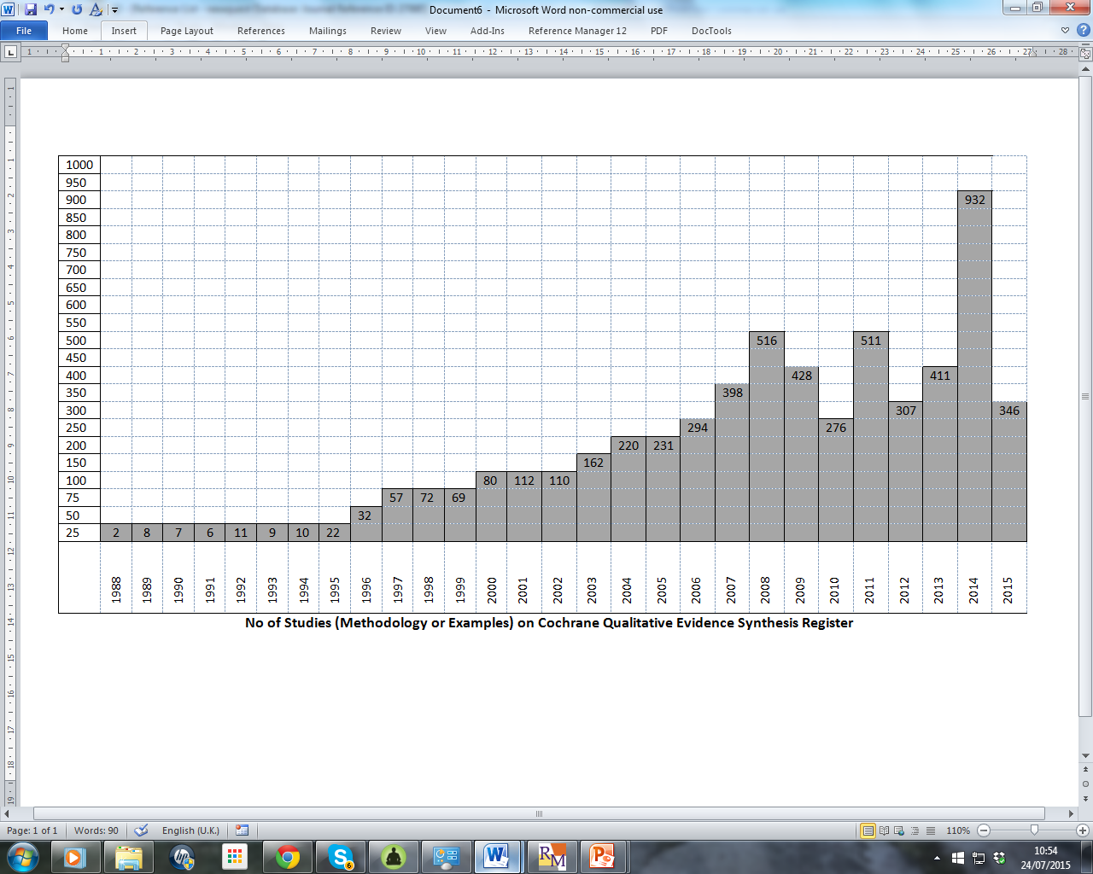
Qualitative Evidence Synthesis (QES) - exciting and growing field of systematic review

Slide 4
The Rise and Rise of “Qualitative Metasynthesis”
“As a very broad index of the activity in this space, a Google scholar search for “qualitative metasynthesis” citations reveals a steady acceleration from 10 new publications for the calendar year in 1995 to 38 in 2000, 245 in 2005, 985 in 2010, and 3,250 in 2015”.
Thorne S. Metasynthetic Madness: What Kind of Monster Have We Created? Qual Health Res. 2017 Jan;27(1):3-12.

Slide 5
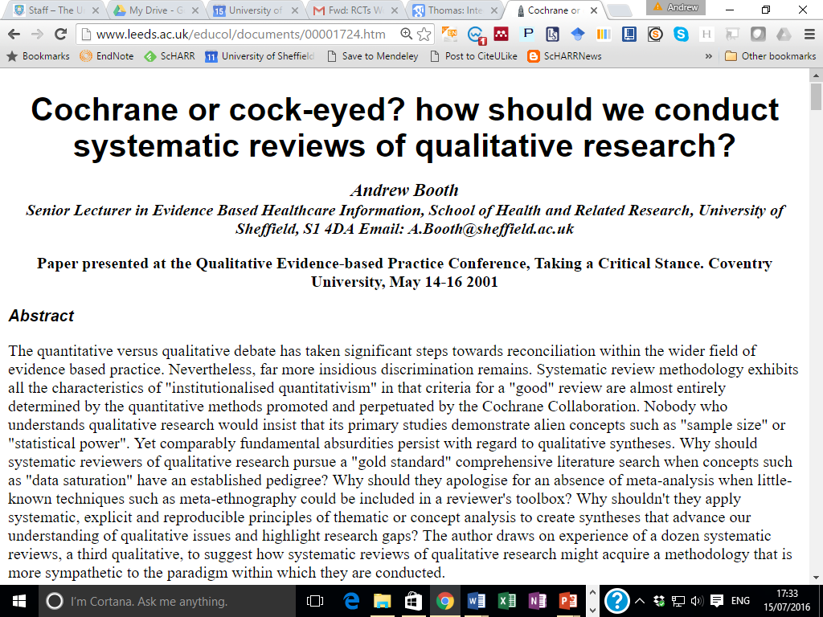

Bias?
Bias?
Bias?
Bias?
Bias?
Bias?
Bias?
Bias?
Bias?
Bias?
Bias?
Bias?
Bias?
Bias?
Bias?
Bias?
Bias?
Bias?
Bias?
Bias?
Bias?

Slide 6

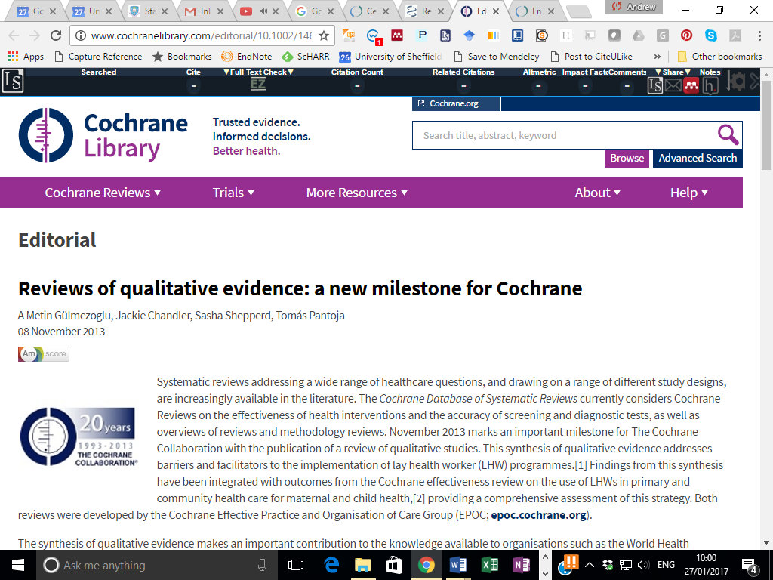
WHO-sponsored QES in Cochrane Library
Qualitative
Effectiveness

Slide 7

Specific Methods
Bayesian Meta-Synthesis
Meta- Aggregation
Critical Interpretive Synthesis
Meta-Interpretation
Meta Narrative
Matrix Method
Meta Study
Best Fit Synthesis
Framework Synthesis
Narrative Synthesis
Realist Synthesis
Meta-Ethnography
EPPI-Centre Method
Thematic Synthesis

Slide 8
Confusing Terminology, Variety of Choices
Qualitative Systematic Review
Qualitative Meta-Synthesis
Qualitative Research Synthesis
Qualitative Evidence Synthesis
Qualitative Interpretive Meta-Synthesis
Best Fit Synthesis
Critical Interpretive Synthesis
Framework Synthesis
Meta-Aggregation
Meta-Ethnography
Meta-Interpretation
Meta-Narrative
Meta-Study
Meta-Summary
Narrative Synthesis
Qualitative Meta-Synthesis
Realist Synthesis
  19. Rapid Realist Synthesis
Thematic Synthesis

Slide 9
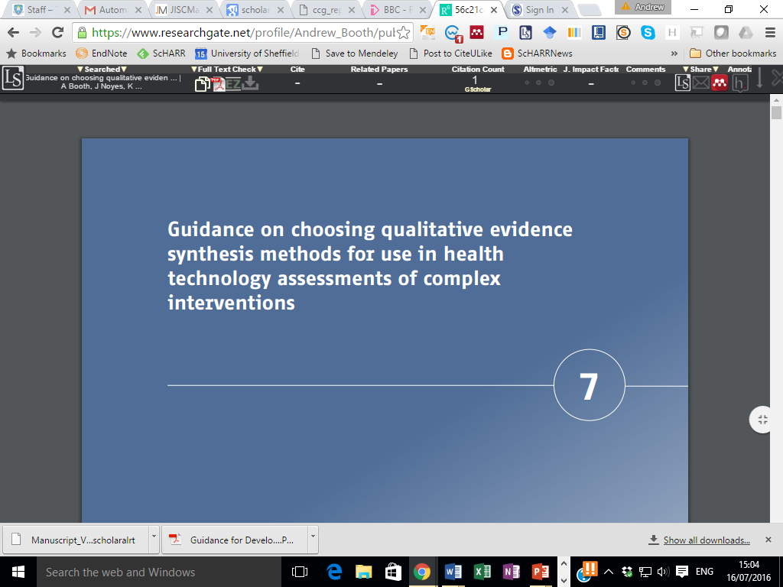
Integrate HTA
BOOTH, A., NOYES J, FLEMMING K, GERHARDUS, A., WAHLSTER, P., VAN DER WILT, G.J., MOZYGEMBA, K., REFOLO, P., SACCHINI, D., TUMMERS, M., REHFUESS, E. (2016) Guidance on choosing qualitative evidence synthesis methods for use in health technology assessments of complex interventions [Online]. Available from: http://www.integrate-hta.eu/downloads/

Slide 10
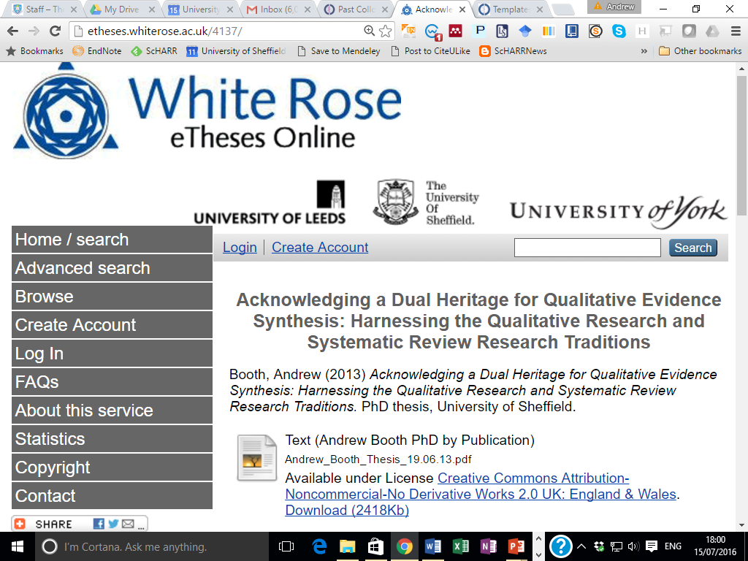
QES inhabits an uncertain meeting point between systematic review methods and primary qualitative research

Slide 11
Dual heritage!
‘Dual heritage’ literally refers to having parents from different cultural (and/or ethnic) backgrounds. By extension it is used metaphorically to indicate the rich diversity accessed by QES in drawing upon the cultures, or research traditions, of both qualitative research and systematic review.
We…acknowledge that qualitative research is, itself, constituted of multiple cultures and traditions, some almost as distant from each other as quantitative research is from qualitative research. However a pragmatic focus permits dipping judiciously into this methodological ‘gene pool’, the entire qualitative ‘genome’, so to speak,
Booth (2013)

Slide 12
Experimentation and Borrowing
Thomas & Harden (2008) acknowledge this dual heritage:
“When we started…reviews which included qualitative research in 1999, there was very little published material that described methods for synthesising this type of research”.
“We therefore experimented with a variety of techniques borrowed from standard systematic review methods and methods for analysing primary qualitative research”.
For example:
“A review team might use literature searches to operationalize maximum variation sampling by accessing disciplines or schools of thought that emphasize diversity and dissonance” [Booth, Desperately Seeking Dissonance]
This latter observation…confirms an earlier comment:
“other principles from primary qualitative research methods may also be ‘borrowed’ such as deliberately seeking studies which might act as negative cases, aiming for maximum variability and, in essence, designing the resulting set of studies to be heterogeneous, in some ways, instead of the homogeneity that is often the aim in statistical meta-analyses (Thomas & Harden, 2008),

Slide 13
When QES “mimics” quantitative systematic review it becomes Frankenstein’s Monster!
“What one sees in these not particularly intellectually rigorous published products is a technical report that puts the reader at a considerable distance from the thinking scholars who generated the original qualitative findings. Often these reports mimic the style and format of the products of the evidence synthesis done by the Cochrane Collaboration with which we have all become familiar.”
“these kinds of studies produce a form of technical report that strips the context from the original studies, typically characterizing the body of work through oversimplifications of complex human phenomena. “
Thorne S. Metasynthetic Madness: What Kind of Monster Have We Created? Qual Health Res. 2017 Jan;27(1):3-12.

Slide 14
Mimicking Quantitative Reviews
“they are privileging standardized technique over interpretive imagination, conceptual depth, and the insights that could be obtained from cross fertilization across diversities. These kinds of technical reports often reveal nothing of the gorgeous and evocative depth and details reported in the original studies, and grossly misrepresent what they reported as findings by virtue of ignoring that which is not common across the full body of work”.
Thorne S. Metasynthetic Madness: What Kind of Monster Have We Created? Qual Health Res. 2017 Jan;27(1):3-12.

Slide 15
When appropriate and sensitive to the primary qualitative tradition QES makes a valuable contribution to knowledge
“Building on the benefits of getting more specific, doing systematic reviews can also be an important impetus for creativity….While doing systematic reviews, creative sparks fly.” (Clark, 2016)
“High-quality qualitative metasynthesis should be a deconstructive and interpretive exercise, judged by its capacity to allow us to see the evolving collective knowledge in its unfolding, to understand its intricate particularities, and to appreciate the limits and conditions of what we comfortably agree upon and where the debate may continue“. (Thorne, 2016)

Slide 16
Comprehensive versus purposive
Exhaustion versus theoretical saturation
Quality Assessment as a Hurdle versus Quality Assessment as a Moderator/ Muffler
Differences in PICO versus Differences in Context/Concept
Average versus Dissonance

Slide 17
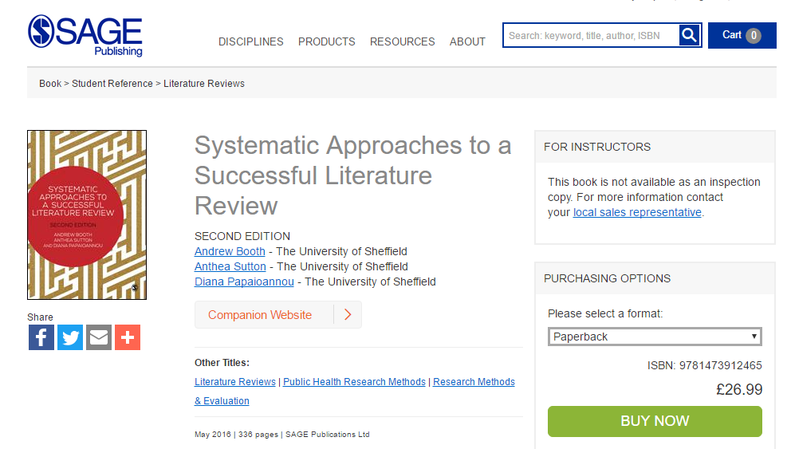
New Book
The Source/ Sauce of SALSA!!
“The second edition of this text is most welcome. The new chapter on selecting your review methods is excellent, readable and scholarly. There is more practical guidance on rapid reviews and integrating qualitative and quantitative data…The new content on review tools and more highly developed secondary data research such as concept analysis are great additions.” Sue Schutz; Senior Lecturer, Health/Life Sciences, Oxford Brookes University

Slide 18
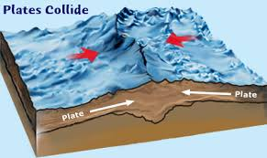
Where Paradigms Collide!
QES
Systematic Reviews
Primary Qualitative Research

Slide 19
Where Tectonic Plates Collide (SALSA):
Search (including Questions and Sampling)
AppraisaL
Synthesis
Analysis & presentation

Slide 20
Where Tectonic Plates Collide – 1(a) The Question
PICO | SPICE | Other Considerations
Population/Patient | Setting Perspective | As per Grounded Theory question may emerge iteratively from Data
Intervention | Interest, Phenomenon of | PICOs of Effectiveness and Qualitative Question may not be: Co-terminous [Shortage of Qualitative “Intervention” Studies] therefore may use Experience of Disease Studies (Lorenc et al, 2012)
Comparison | Comparison (if any)
Outcome(s) | Evaluation
Lorenc, T., Pearson, M., Jamal, F., Cooper, C., & Garside, R. (2012). The role of systematic reviews of qualitative evidence in evaluating interventions: a case study. Research synthesis methods, 3(1), 1-10.

Slide 21
Where Tectonic Plates Collide – 1(b) Sampling Studies
Booth, A. (2016). Searching for qualitative research for inclusion in systematic reviews: a structured methodological review. Systematic reviews,5(1), 1..

Slide 22
Patton’s 16 Sampling Strategies
Typical cases
Snowball or Chain
Criterion
Random
Politically important cases
Random purposeful
Confirming and disconfirming cases
Homogenous
Extreme or deviant cases
Theory based
Opportunistic or emergent
Intensity
Maximum variation
Stratified purposeful
Convenience
Critical Case

Slide 23
Where Tectonic Plates Collide – 1(c) Searching
Quantitative Systematic Reviews | Primary Qualitative Research
A priori Search Strategy | Iterative, Recursive Searching
Focus on Bibliographic Database Searching | Focus on Supplementary Search Techniques (Papaioannou et al, 2010)
Focus on Journal Articles | Use of Theses, Grey Literature, Book Chapters (Stansfield et al, 2014)
 | Need for Contextually-specific Data (Stansfield et al, 2012)
Booth, A. (2016). Searching for qualitative research for inclusion in systematic reviews: a structured methodological review. Systematic reviews,5(1), 1..
Papaioannou, D., Sutton, A., Carroll, C., Booth, A., & Wong, R. (2010). Literature searching for social science systematic reviews: consideration of a range of search techniques. Health Information & Libraries Journal, 27(2), 114-122.

Slide 24
Where Tectonic Plates Collide – 1(c) Searching
Contextual Thickness | Conceptual Richness
Ref: Booth, A., Harris, J., Croot, E., et al. (2013). Towards a methodology for cluster searching to provide conceptual and contextual “richness” for systematic reviews of complex interventions… (CLUSTER). BMC Med Res Methodol, 13(1), 1. (cp. Qualitative methods of “berry-picking” (Bates, 1989)) | Ref: Booth, A., & Carroll, C. (2015). Systematic searching for theory to inform systematic reviews: is it feasible? Is it desirable?. Health Information & Libraries Journal, 32(3), 220-235. Noyes J., Hendry M., Booth A., et al. (2016) Current use was established and Cochrane guidance on selection of social theories for SRs of complex interventions was developed. Journal of Clinical Epidemiology
Mnemonic: CLUSTER | Mnemonic: BeHEMoTh
Citations | Behaviour
Lead Authors | Health Condition
Unpublished materials | Exclusions
Scholar searches | Models or Theories
Theories
Early Examples | Context/Theory – the bits of the article that quantitative reviewers (used to) strip and throw aside!
Related Projects

Slide 25
Where Tectonic Plates Collide – 2. AppraisaL (Quality Assessment)
“Quality assessment is a methodological “tectonic pressure point” where the dual heritages of systematic review and primary qualitative research come into shuddering juxtaposition.
Epistemological and practical differences can be detected at every level of the debate, from what is meant by “quality” through the role of checklist and criteria to the appropriate course of action when studies fall short of minimal quality”.
Thomas & Harden (2008): “In systematic reviews of trials, 'sensitivity analyses' – analyses which test the effect on the synthesis of including and excluding findings from studies of differing quality – are often carried out. Dixon-Woods et al. [12] suggest that assessing the feasibility and worth of conducting sensitivity analyses within syntheses of qualitative research should be an important focus of synthesis methods work.”
Carroll & Booth (2016)“recent research indicates that sensitivity analysis offers one potentially useful means for advancing this controversial issue”.

Slide 26

Role of Quality Assessment?
“a study report that might not reflect the best example of a coherent and fulsome ethnographic report could well surface some insights about the population under study that shed light on an aspect of experience, not previously understood by health care practitioners caring for patients within that population. Thus, the decision to eliminate that study arbitrarily by virtue of its fit with ethnographic research guidelines may obscure a germ of possibility that, if used to interrogate the reports of other studies, could have led to important new angles of consideration (Pawson, 2007)”.
(Thorne, 2017)
Pawson’s idea of the “Nugget” (Pawson, 2007)

Slide 27
Where Tectonic Plates Collide – 3 Synthesis
Challenge – How do you make iterative processes such as framework synthesis (based on framework analysis) systematic transparent and reproducible?
[One] Answer: Best Fit Framework Synthesis
Why? : Because it engineers a transparent and visible chasm between deductive and inductive stages.
“Best-fit” framework synthesis
  Identify relevant pre-existing conceptual models or frameworks
  Identify and extract all relevant qualitative studies satisfying review’s inclusion criteria
  Code data from included studies against framework
  Use secondary thematic analysis/synthesis to generate completely new themes to supplement the framework’s themes
  Create new framework and conceptual model or theory

Slide 28
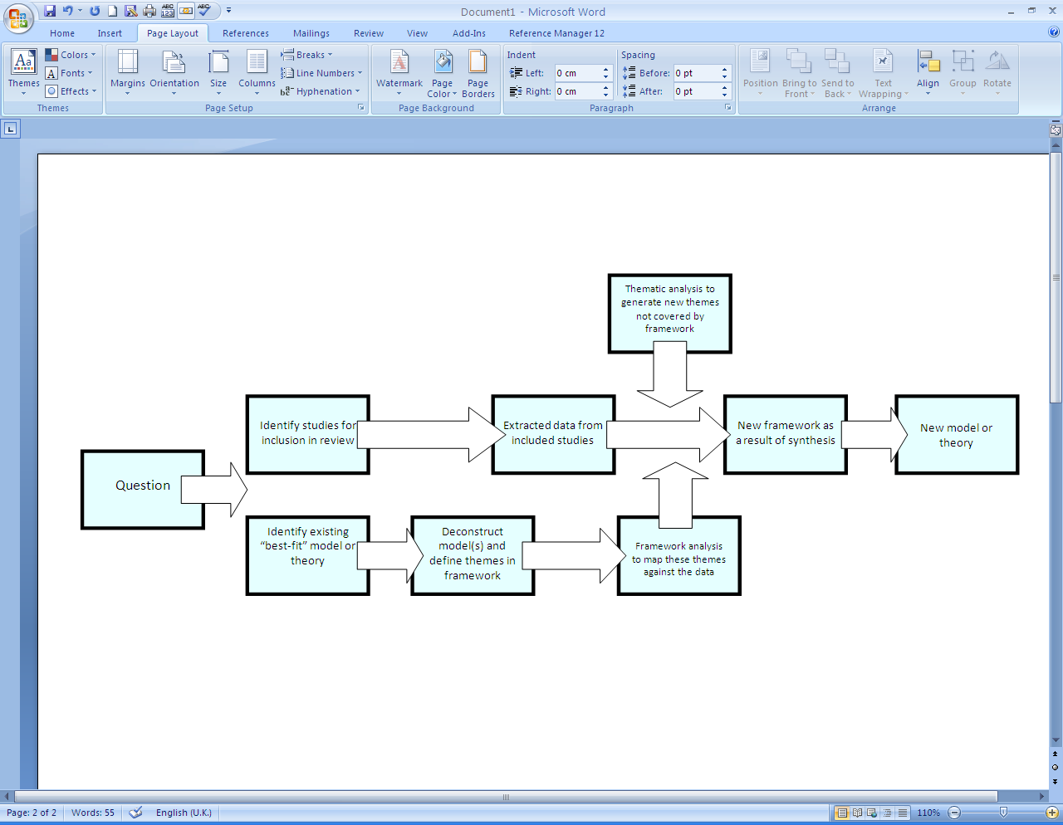
Thematic synthesis
Framework synthesis

Slide 29
Where Tectonic Plates Collide – 4 - Analysis (Based on Miles and Huberman,1994)
Table 9.2 Elements of data analysis
(Based on Miles and Huberman,1994)
Elements | Application within synthesis methods
Noting patterns and themes | Meta-ethnography, thematic synthesis
Seeing plausibility (ensuring conclusions make good sense) | Meta-ethnography
Clustering | Content analysis, framework synthesis, meta-ethnography, thematic synthesis
Making metaphors | Meta-ethnography, meta-narrative review
Counting | Cross-case analysis, meta-analysis, meta-summary
Making contrasts/comparisons | Meta-ethnography, meta-narrative review
Partitioning variables | Framework synthesis, meta-ethnography, meta-analysis
Subsuming particulars into the general | Meta-analysis, meta-ethnography
Noting relations between variables | Logic models, realist synthesis
Finding intervening variables | Logic models, realist synthesis
Building a logical chain of evidence | Logic models, realist synthesis
Making conceptual/theoretical coherence | Concept maps, logic models, meta-ethnography, metanarrative review, realist synthesis

Slide 30
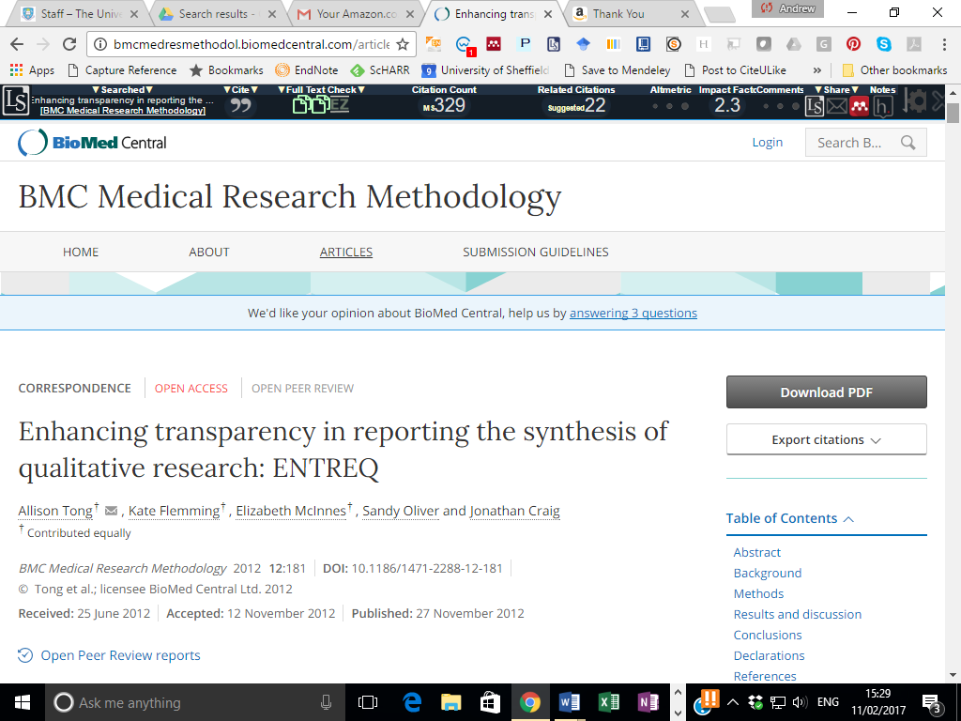
Presentation
eMERGe – Meta-ethnography Reporting Guidelines
ENTREQ
48 | Discussion - reflexivity | State reviewer(s)’ background or perspectives that may have influenced the interpretive process
DRAFT
PRISMA for Qualitative Synthesis?

Slide 31
In Summary
Search – Starts from notions of similarity but is revealed as suited to primary qualitative sampling approaches
AppraisaL – Starts from fundamentally different intent but benefits from technique of sensitivity analysis (from quant SRs)
Synthesis – Employs previous primary qualitative approach but adapts this to make it systematic, explicit and reproducible (from quant SRs)
Analysis – Currently under-used tool-kit from primary qualitative research (present in some qualitative evidence synthesis methodologies)
Presentation – Slavishly imitates PRISMA standards

Slide 32
“Unsound” QES applications are no justification for not performing QES at all!
“the current proliferation of superficial technical reports as a legitimate metasynthesis product seems to have been fueled by a set of uncritically held assumptions: that scholarly integrity within metasynthesis is primarily a product of adherence to a formulaic approach to data management, that it is appropriate to base judgments about the quality of past scholarly contributions on new sensibilities associated with standardized reporting, and that the identification of commonalities and patterns across a set of published studies constitutes a reasonable approximation of their collective contribution”.
“Taken together, these assumptions have played a role in creating a hollow and rather useless form of scholarship that does not substantially add value to the field, and instead, conveys the message that what has been superficially summarized is perhaps all that was there.” (Thorne, 2017)

Slide 33
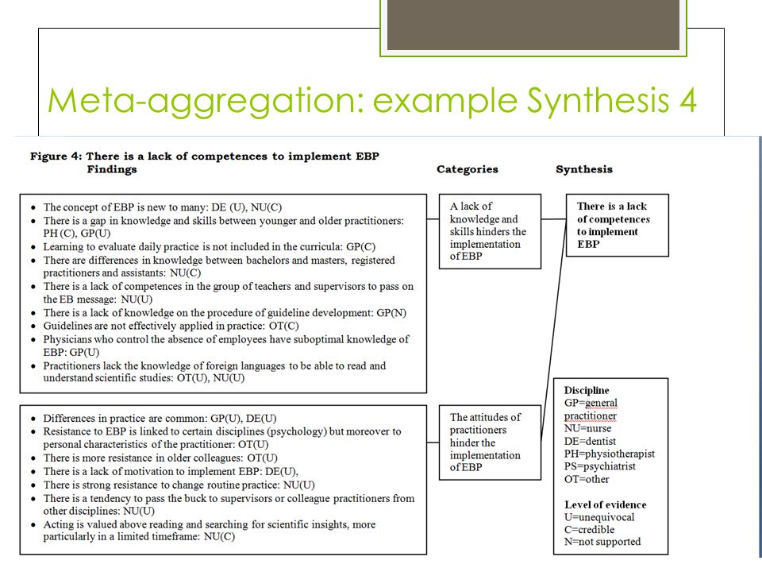
Adherence to a formulaic approach

Slide 34
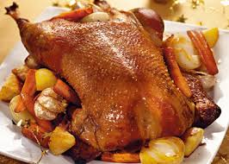
Stuffing the Goose that lays the Golden Eggs!
“It seems that the problem has been further complicated by the bells and whistles of formulaic search and selection techniques, such that this new species of work has taken hold. It is regrettable that the idea that spawned qualitative metasynthesis seems to be getting lost in the translation”.
“In putting these arguments to ink, I would hope to further the kinds of conversations that may help us return to the promise that qualitative metasynthesis offered as a scholarly approach with the potential to advance a field of study”. (Thorne, 2017)

Slide 35
Cp. Criticisms of Meta-analysis
"This mixing of diverse studies can make for a strange fruit salad: mixing apples and oranges may seem reasonable enough but when sprouts, turnips or even an old sock are added, it can cast doubt on the meaning of any aggregate estimates". – What is meta-analysis? What If series 1st Edition.
“An exercise in mega-silliness”
"an abuse of research integration”
"an obstetrical Baader-Meinhof gang.”
"a tool has become a weapon.”

Slide 36
A Burgeoning Research Agenda!
QES should be considered of their own species but can benefit from both traditions, if selected judiciously
Lorenc et al, 2012: “such reviews are, to some extent, methodologically sui generis and cannot be governed solely [Italics added] by concepts imported either from SRs of quantitative evidence (e.g. comprehensiveness) or from primary qualitative research (e.g. saturation)” - the Author (i.e. me!) looks forward to operating within a methodological state of flux that offers stimulus for years to come”. (Booth, 2013)

Slide 37
QES methods can expand the systematic review toolbox!
Use of Sampling – Alternatives to exhaustive searching
Role of Iterative Searches
Role of complementary search methods
Appropriate role of Quality Assessment
Qualitative Sensitivity Analysis
Use of Theory
Understanding of Context
Presentation of Conceptual Frameworks
Pursuit of Dissonance

Slide 38
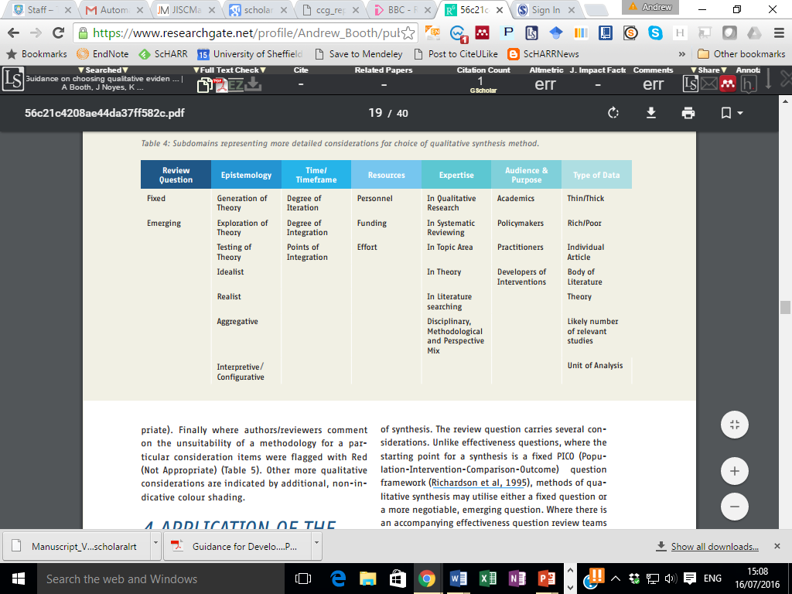
RETREAT: Review Question – Epistemology – Time/Timeframe – Resources – Expertise – Audience – Type of Data: a revised mnemonic outlining considerations when planning a qualitative synthesis

Slide 39

Qualitative Evidence Synthesis

Slide 40
Supporting References
Bates, M. J. (1989). The design of browsing and berrypicking techniques for the online search interface. Online review, 13(5), 407-424.
Booth, A. (2013). Acknowledging a Dual Heritage for Qualitative Evidence Synthesis: Harnessing the Qualitative Research and Systematic Review Research Traditions (Doctoral dissertation, University of Sheffield).
Clark, A. M. (2016). Why Qualitative Research Needs More and Better Systematic Review. International Journal of Qualitative Methods, 15(1). doi:10.1177/1609406916672741
Stansfield, C., Kavanagh, J., Rees, R., Gomersall, A., & Thomas, J. (2012). The selection of search sources influences the findings of a systematic review of people’s views: a case study in public health. BMC medical research methodology, 12(1), 1.
Stansfield, C., Brunton, G., & Rees, R. (2014). Search wide, dig deep: literature searching for qualitative research. An analysis of the publication formats and information sources used for four systematic reviews in public health. Research synthesis methods, 5(2), 142-151.
Thomas, J., & Harden, A. (2008). Methods for the thematic synthesis of qualitative research in systematic reviews. BMC medical research methodology, 8(1), 1.
Thorne S. Metasynthetic Madness: What Kind of Monster Have We Created? Qual Health Res. 2017 Jan;27(1):3-12.

